Slide 1
Mid-Atlantic Permanente Medical Group
Pregnancy Assessment
Neel Kawitkar

Slide 2
Contents
Objective
Assumptions
MySQL Code Snippets
Conclusion

Slide 3
Objective
Identifying the eligible population.
Calculating the pregnant females who visited OBGYN provider in a timely manner.

Slide 4
Assumptions
The gender considered for eligible population from the given dataset is females only.
To be considered as eligible population, patient should have the due date after the encounter date.
While calculating the denominator, if there are multiple encounters, only first encounter from the eligible population is considered for calculation purpose.
Age of the patient is calculated as of the encounter date.

Slide 5
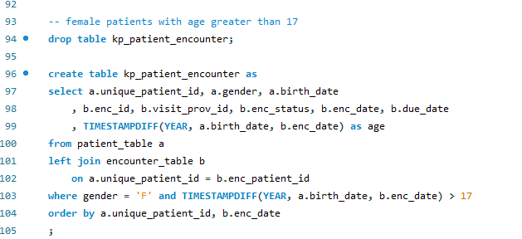
MySQL Code – Female patients with age greater than 17

Slide 6
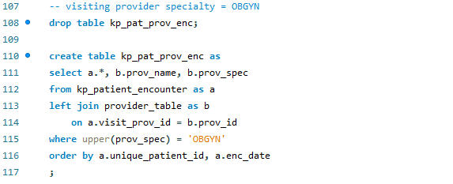
MySQL Code – Visiting provider specialty is OBGYN

Slide 7
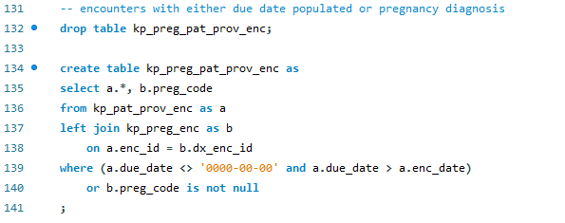
MySQL Code – Encounters with either due date populated or pregnancy diagnosis

Slide 8
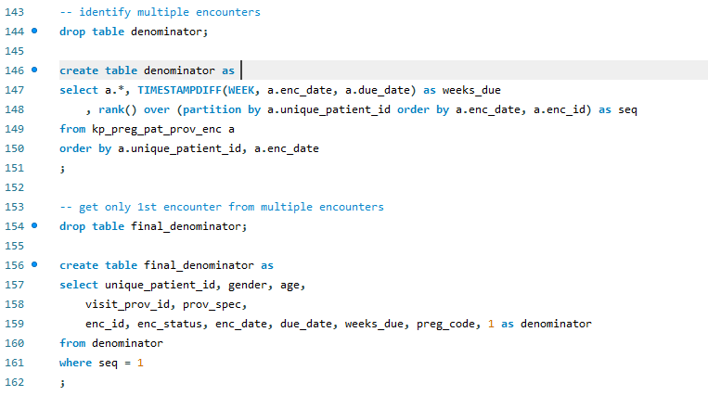
MySQL Code – Identifying the first encounter from multiple encounters

Slide 9
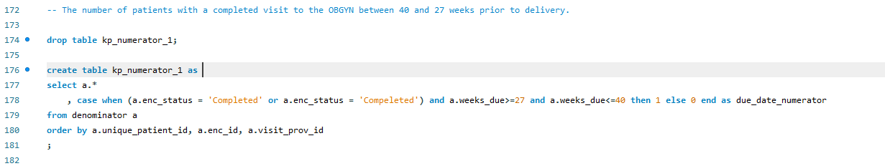
MySQL Code – Patients with completed visits to OBGYN between 40 and 27 weeks prior to delivery

Slide 10
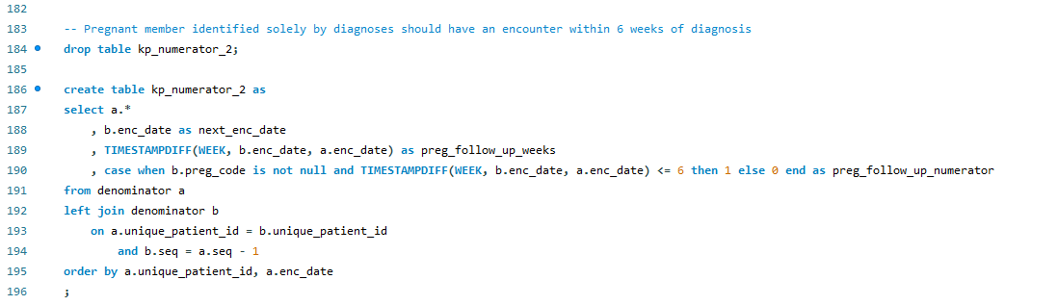
MySQL Code – Pregnant members identified within 6 weeks of diagnosis

Slide 11
Conclusion
Eligible population = 1134
Pregnant females who visited OBGYN provider in timely a manner = 275
The percentage of pregnant females who visited OBGYN provider in a timely manner = 24.25 %

Slide 12
Thank you!

